Slide 1
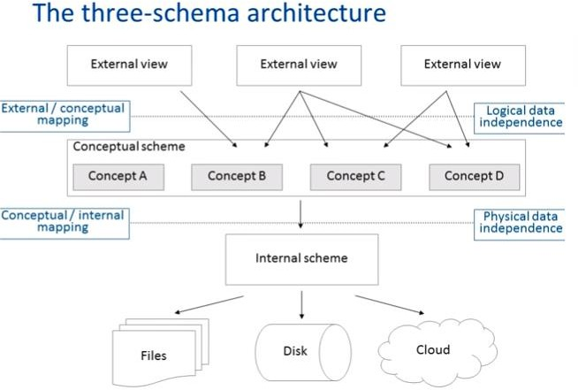
View of Data

Slide 2
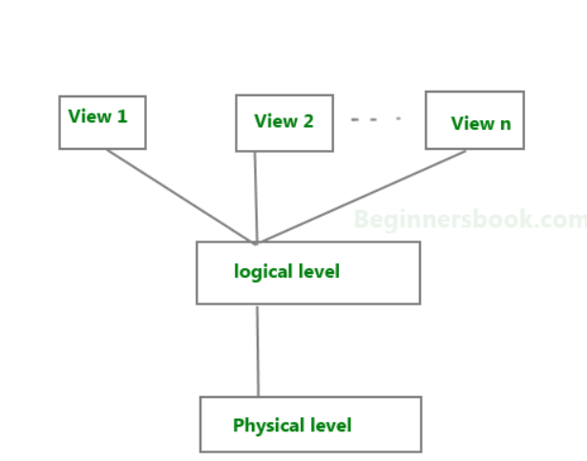

Slide 3
View or External level : This is the highest level of abstraction.
This level describes the user interaction with database system.
Only a part of the actual database is viewed by the users.
This level exists to ease the accessibility of the database by an individual user. Users view data in the form of rows and columns.
Tables and relations are used to store data.
Users can just view the data and interact with the database, storage and implementation details are hidden from them.
Logical or conceptual level:
This is the middle level of 3-level data abstraction architecture. It describes what data is stored in database..
Physical or Internal level:
This is the lowest level of data abstraction. It tells us how the data is actually stored in memory.

Slide 4
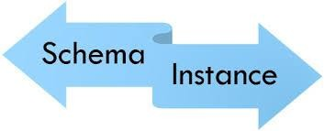
Definition of schema: Design of a database is called the schema.
For example: An employee table in database exists with the following attributes:
EMP_NAME EMP_ID EMP_ADDRESS EMP_CONTACT -------- ------ ----------- -----------
This is the schema of the employee table.
Schema defines the attributes of tables in the database.
Schema is of three types: Physical schema, logical schema and view schema.

Slide 5
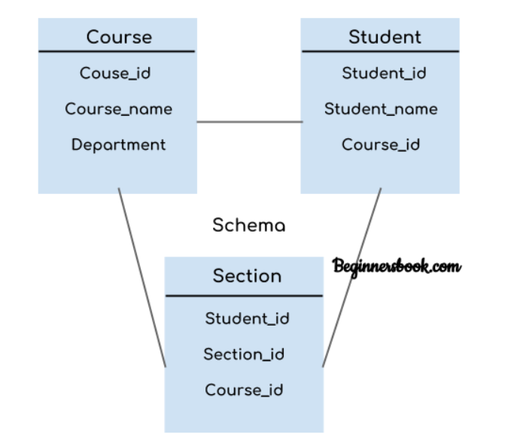
The diagram only shows the design of the database, it doesn’t show the data present in those tables

Slide 6
.
Physical schema
The design of a database at physical level is called physical schema, how the data stored in blocks of storage is described at this level.
Logical schema
Design of database at logical level is called logical schema,
programmers and database administrators work at this level,
at this level data can be described as certain types of data records gets stored in data structures.
View schema
Design of database at view level is called view schema.
This generally describes end user interaction with database systems.

Slide 7
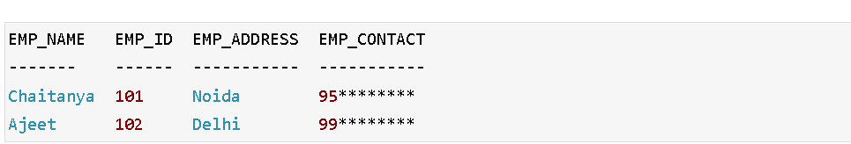
DBMS Instance
Definition of instance: The data stored in database at a particular moment of time is called instance of database.

Slide 8
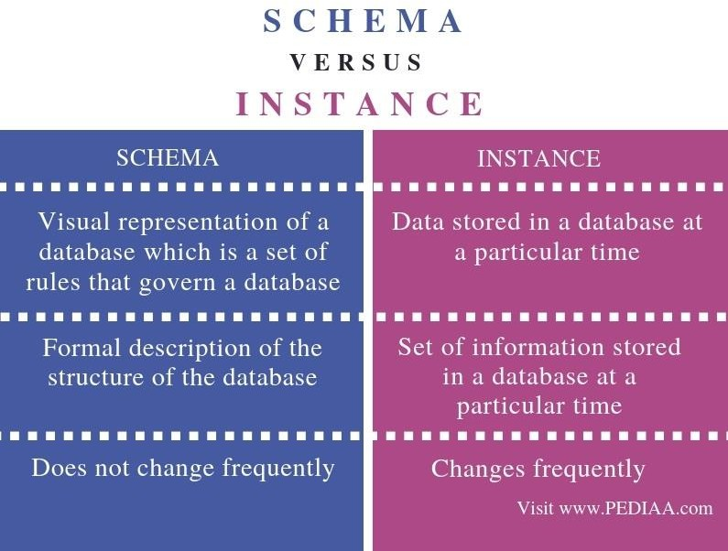

Slide 9
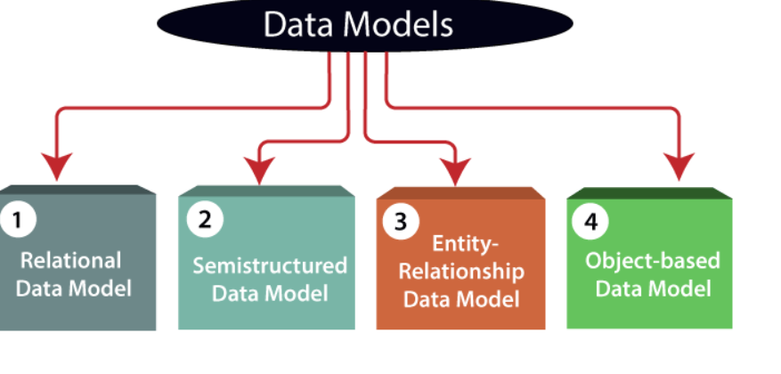
DATA MODELS

Slide 10
DATA MODELS
Relational Data Model: This type of model designs the data in the form of rows and columns within a table. Tables are also called relations
Entity-Relationship Data Model:
An ER model is the logical representation of data as objects and relationships among them.
These objects are known as entities, and relationship is an association among these entities
Object-based Data Model:
An extension of the ER model with notions of functions, encapsulation, and object identity, as well.
This model supports a rich type system that includes structured and collection types.
Semistructured Data Model:Semi-structured data is a type of data that is not purely structured, but also not completely unstructured. For example, an XML document might contain tags that indicate the structure of the document.

Slide 11

DATABASE MODELS
Record-based logical models
–Relational Model
–Network Model
–Hierarchical Model
–Object-Oriented Model
–Entity-Relationship Diagram

Slide 12
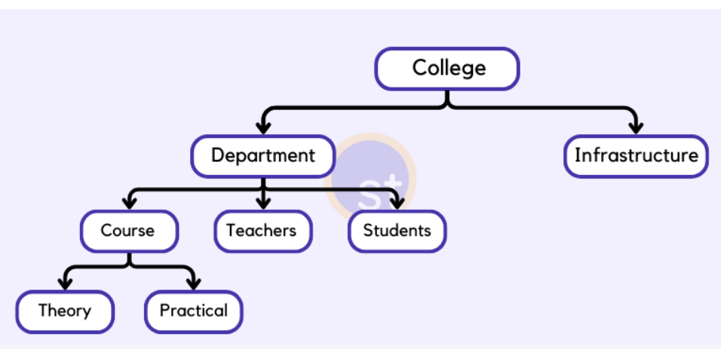
Hierarchical Database Model
The hierarchical database model organizes data into a tree-like structure, with a single root, to which all the other data is linked.
The hierarchy starts from the Root data, and expands like a tree, adding child nodes to the parent nodes.
In this model, a child node will only have a single parent node.
.

Slide 13
Advantages and disadvantages
As it has one-to-many relationships between different types of data so it is easier and fast to fetch the data.
DISADVANTAGES
But the Hierarchical model is less flexible.
And it doesn't support many-to-many relationships.

Slide 14
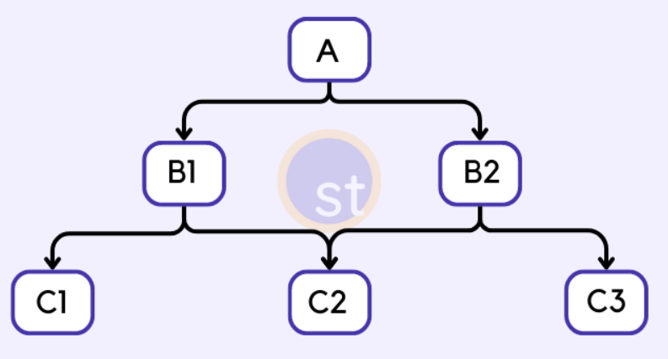
Network Model
The Network Model is an extension of the Hierarchical model.
In this model, data is organized more like a graph, and allowed to have more than one parent node.
This database model uses many-to-many data relationships.
.

Slide 15
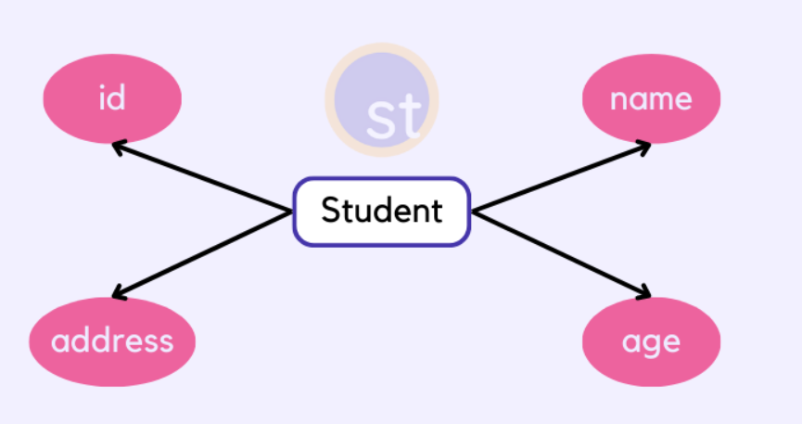
Advantages and disadvantages of the Network Model
It supports complex relationships
It allows more flexibility
disadvantages
The implementation of the Network model is complex, and it's very difficult to maintain it.
The Network model is difficult to modify also
3. Entity-relationship Model
In this database model, relationships are created by dividing objects into entities and their characteristics into attributes.
ER Models are defined to represent the relationships in pictorial form to make it easier for different stakeholders to understand.

Slide 16
Advantages of the ER Model
It is easy to understand and design.
As the ER model cannot be directly implemented into a database model.
4. Relational Model
The basic structure of data in the relational model is tables.
All the information related to a particular type is stored in rows of that table.
This model was introduced by E.F Codd in 1970.
Hence, tables are also known as relations in the relational model.
you can design tables, normalize them to reduce data redundancy, and use Structured Query language or SQL to access data from the tables.
Some of the most popular databases are based on this database model. For example, Oracle, MySQL, etc.

Slide 17
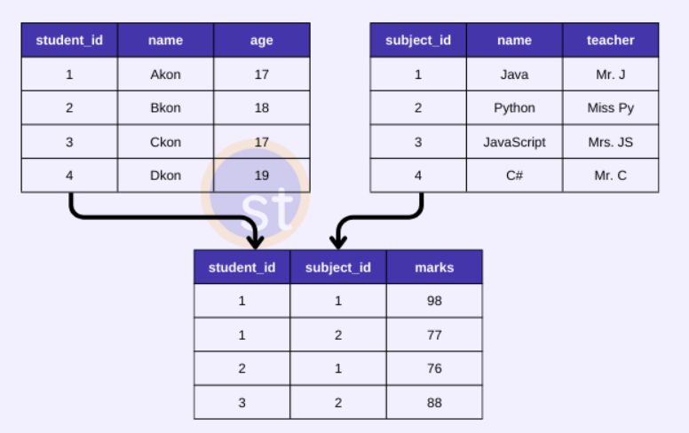
Relational Model
Advantages of the Relational Model
It's simple and easy to implement.
It supports SQL using which you can easily query the data.

Slide 18
Object-oriented database model
5. Object-oriented Model
In this model, data is stored in the form of objects.
The behavior of the object-oriented database model is just like object-oriented programming.
A very popular example of an Object Database management system or ODBMS is MongoDB which is also a NoSQL database.
This database model is not mature enough as compared to the relational database model.
A multimedia database incorporates media, such as images, that could not be stored in a relational database.
A hypertext database allows any object to link to any other object.
Advantages of the Object-oriented Model
It can easily support complex data structures, with relationships.
It also supports features like Inheritance, Encapsulation, etc.

